Slide 1
BANK MANAGEMENT system

Slide 2
Problem Statement
Banks serve a diverse customer base, each with unique financial needs and preferences. It is essential for a bank to maintain accurate records of customer accounts, facilitate financial transactions, and provide banking services in a systematic and organized manner. The existing manual processes for handling these tasks can be time-consuming, error-prone, and cumbersome.
The objective of the Bank Management System project is to create a software application that facilitates the management of bank accounts and offers various banking services to account holders. This project aims to streamline and automate typical banking operations, ensuring efficient and organized customer service. By successfully implementing this system, banks can significantly improve customer service, reduce manual errors, and offer a wider range of financial services, ultimately enhancing the overall banking experience for account holders.

Slide 3
Data Structure Used
The primary data structure used in this project is a queue. A queue is used to manage and maintain a collection of bank accounts. Each bank account is represented as an object of the BankAccount class, and these objects are stored in a queue. The queue data structure is appropriate for this system because it follows a first-come-first-serve approach, which is common in banking operations. The queue allows for efficient handling of account transactions and ensures that the transactions are processed in the order they are received. Queues are efficient for both adding new accounts and processing transactions. New accounts can be easily added to the back of the queue, and transactions are processed from the front. This ensures that all accounts are handled fairly and in the order they were created.

Slide 4
Why Queues Data Structure is Used?
A queue follows the FIFO principle, which aligns well with typical banking operations. In a real-world bank, customers are usually served in the order they arrive. A queue ensures that customer account transactions are processed in the same order they were initiated. This is essential for maintaining a fair and organized system, just like in a physical bank
First-Come-First-Serve (FIFO) Principle
In the context of the Bank Management System, it is important to efficiently handle both new account creations and account transactions. With a queue, new accounts can be added to the back of the queue, and transactions can be processed from the front, ensuring that all accounts are handled fairly and in the order they were created or requested
Efficiency
Simplicity
Queues are relatively simple data structures, making the implementation and management of the Bank Management System straightforward and less error-prone.

Slide 5
Unlike some other data structures, such as arrays or linked lists, a queue does not require random access to elements. This is important for ensuring that account transactions are processed in a serial manner and not subject to arbitrary order changes.
No Random Access Required
Many banking operations, such as calculating interest, withdrawing money, checking loan eligibility, opening fixed deposits, opening locker facilities, and currency exchange, require sequential processing of accounts. A queue provides a natural way to process accounts one by one, ensuring that each account operation is completed before moving on to the next.
Sequential Processing
Consistent Data Handling
The queue data structure ensures a consistent and predictable order for processing accounts. This consistency is crucial in banking, where accurate record-keeping and transaction order must be maintained to avoid errors and disputes.

Slide 6
Tools Used to Implement
1.C++ Programming Language:
The code is written in C++, which is a widely used and versatile programming language. C++ is known for its performance and allows for both procedural and object-oriented programming, which is evident in this code.
2.Standard Input/Output Streams (iostream):
#include <iostream>: This header file is part of the C++ Standard Library and provides input and output functionality. It allows you to use the cin and cout streams for reading and writing data from and to the console.
3.Queue (queue):
#include <queue>: The <queue> header file provides the queue data structure. It is part of the C++ Standard Library and is used to manage a queue of BankAccount objects in this code. The queue is essential for maintaining the order of account transactions and ensuring a first-come-first-serve (FIFO) order for processing.

Slide 7
4.String (string):
#include <string>: The <string> header file is used to work with strings, allowing you to create and manipulate string objects. In this code, it is used for handling account holder names.
5.Standard Namespace (std):
using namespace std;: This line allows you to use symbols from the std namespace without explicitly specifying the namespace each time. It's a common practice in C++ programs for brevity.
6.Object-Oriented Programming (OOP):
The code employs object-oriented programming principles. It defines a BankAccount class to encapsulate account-related data and operations, which is a fundamental aspect of OOP.
7.Menu System and Control Structures:
The code uses control structures such as if, switch, and do-while loops to create a menu-based interface for interacting with the Bank Management System.
8.Data Structures and Algorithms:
The code makes use of data structures (the queue) and basic algorithms for account management, including deposit, withdrawal, loan eligibility checks, fixed deposit creation, locker facility management, and currency exchange.

Slide 8
Explanation
The provided source code is written in C++ and implements the Bank Management System. It includes functions for calculating interest, making deposits, withdrawals, checking loan eligibility, opening fixed deposits, enabling locker facilities, and currency exchange. The BankAccount class represents individual accounts, and a queue is used to manage these accounts. It allows users to perform various banking operations using a menu-based interface. Let's break down the code and explain each part in detail:
1.Header Inclusions:
The code includes necessary C++ standard library headers:
<iostream>: For input and output operations.
<queue>: To use the queue data structure.
<string>: For string handling.
2.Namespace Declaration:
using namespace std;: This line allows you to use symbols from the std (standard) namespace without needing to prefix them with std::. It simplifies code by avoiding redundant namespace specification.

Slide 9
3.BankAccount Class:
The code defines a class named BankAccount. This class represents a bank account and has several attributes:
name: Account holder's name.
balance: Account balance.
hasDebitCard, hasCreditCard, hasInternetBanking, hasFixedDeposit, and hasLocker: Boolean flags indicating whether the account has specific features.
The class has a constructor that initializes these attributes when a BankAccount object is created. The constructor takes arguments for each attribute.
4. Queue of BankAccount Objects:
The code declares a queue named accounts to store objects of the BankAccount class. This queue is used to manage multiple bank accounts.
5. Banking Operations Functions:
The code defines several functions to perform banking operations:
calculateInterest(double rate): Calculates and adds interest to each account's balance based on the provided interest rate.
deposit():Allows the user to create a new bank account by providing account details and pushes the account onto the queue.
withdraw(): Enables account holders to withdraw money from their accounts if they have sufficient balance.
checkLoanEligibility(): Checks if an account is eligible for a loan based on its balance.
openFixedDeposit():Allows account holders to open a fixed deposit account by adding a specified amount to their balance.
openLocker(): Enables account holders to open a locker facility associated with their account.
exchangeCurrency(): Allows currency exchange by reducing the account balance.

Slide 10
6.Main Function:
The main function is the entry point of the program.
It provides a menu-based interface for users to interact with the Bank Management System.
Users can choose from various options like calculating interest, depositing, withdrawing, checking loan eligibility, opening fixed deposits, opening lockers, exchanging currency, or exiting the program.
The program continues to display the menu until the user chooses to exit.
7.Looping and Control Structures:
The program uses a do-while loop to repeatedly display the menu and process user input until the user chooses to exit (option 8).

Slide 11
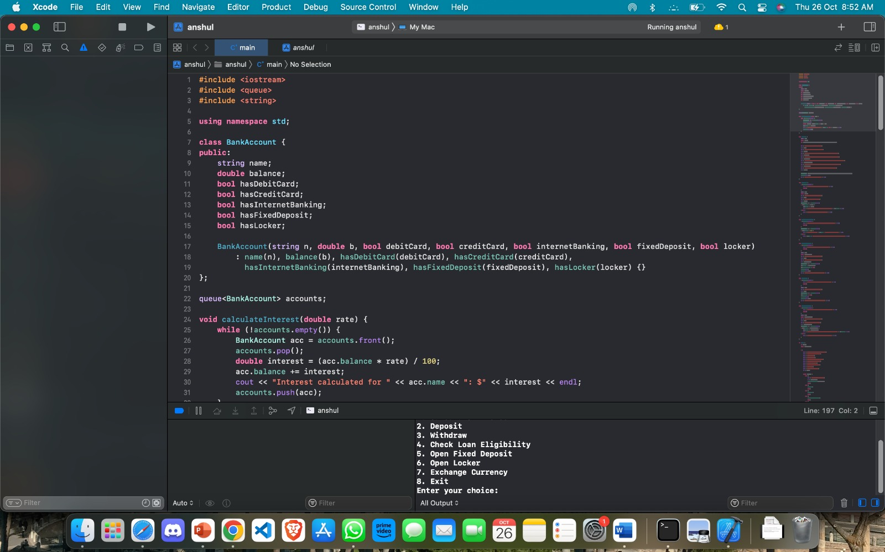
Source Code

Slide 12
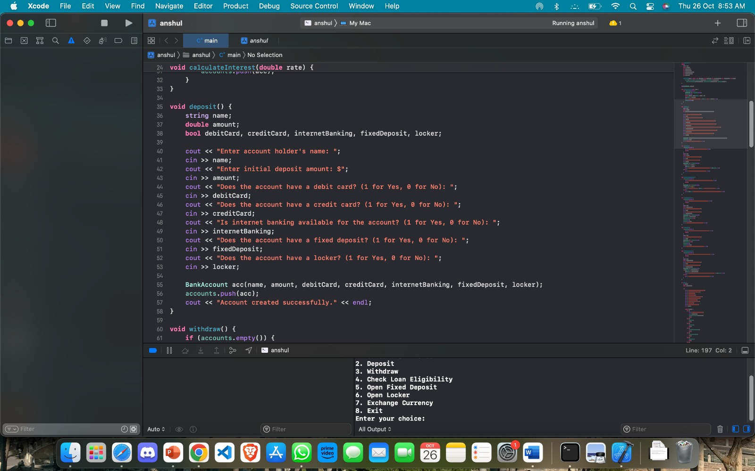

Slide 13
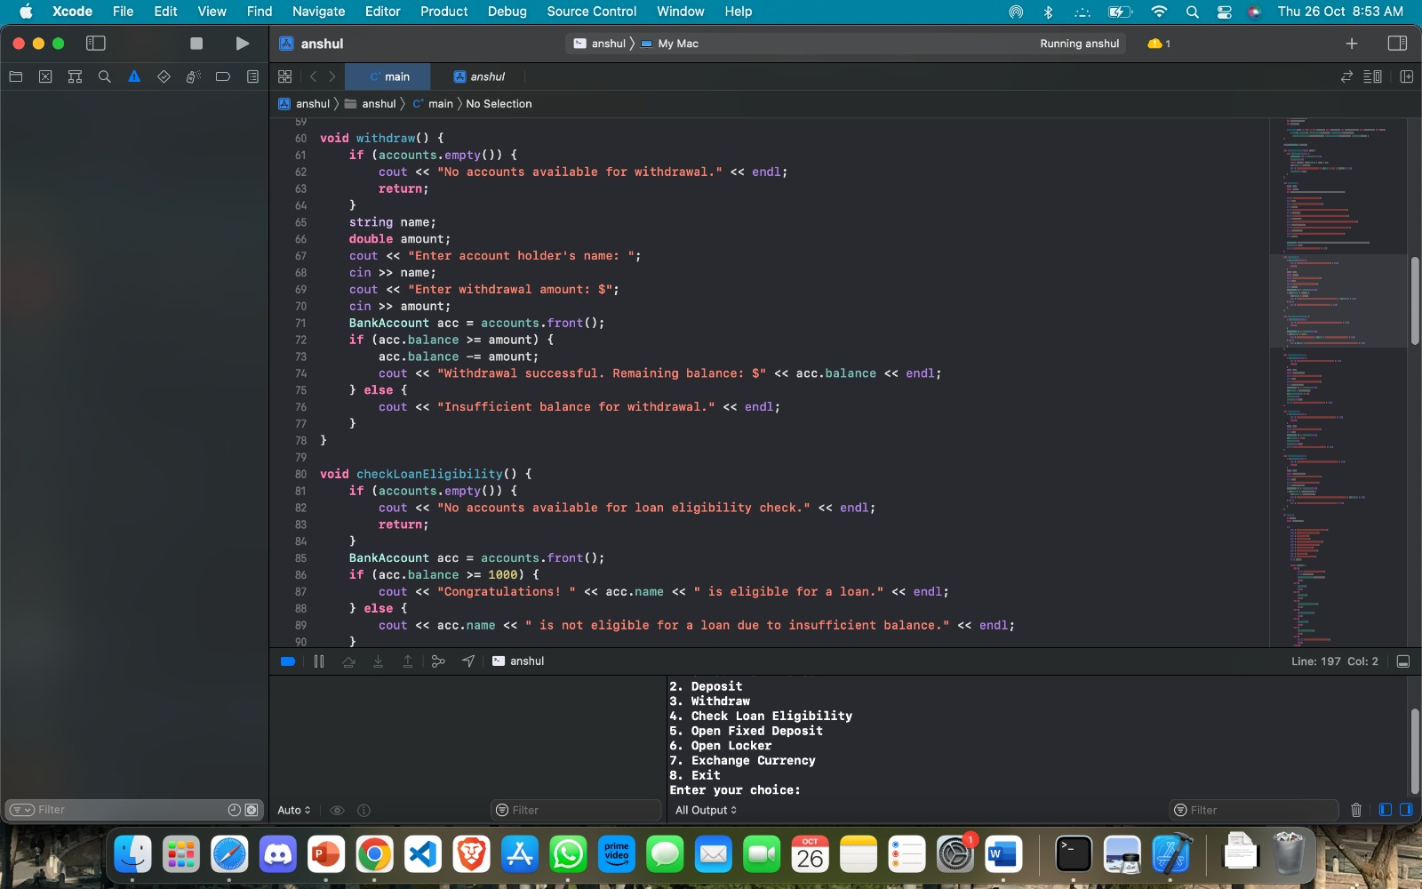

Slide 14
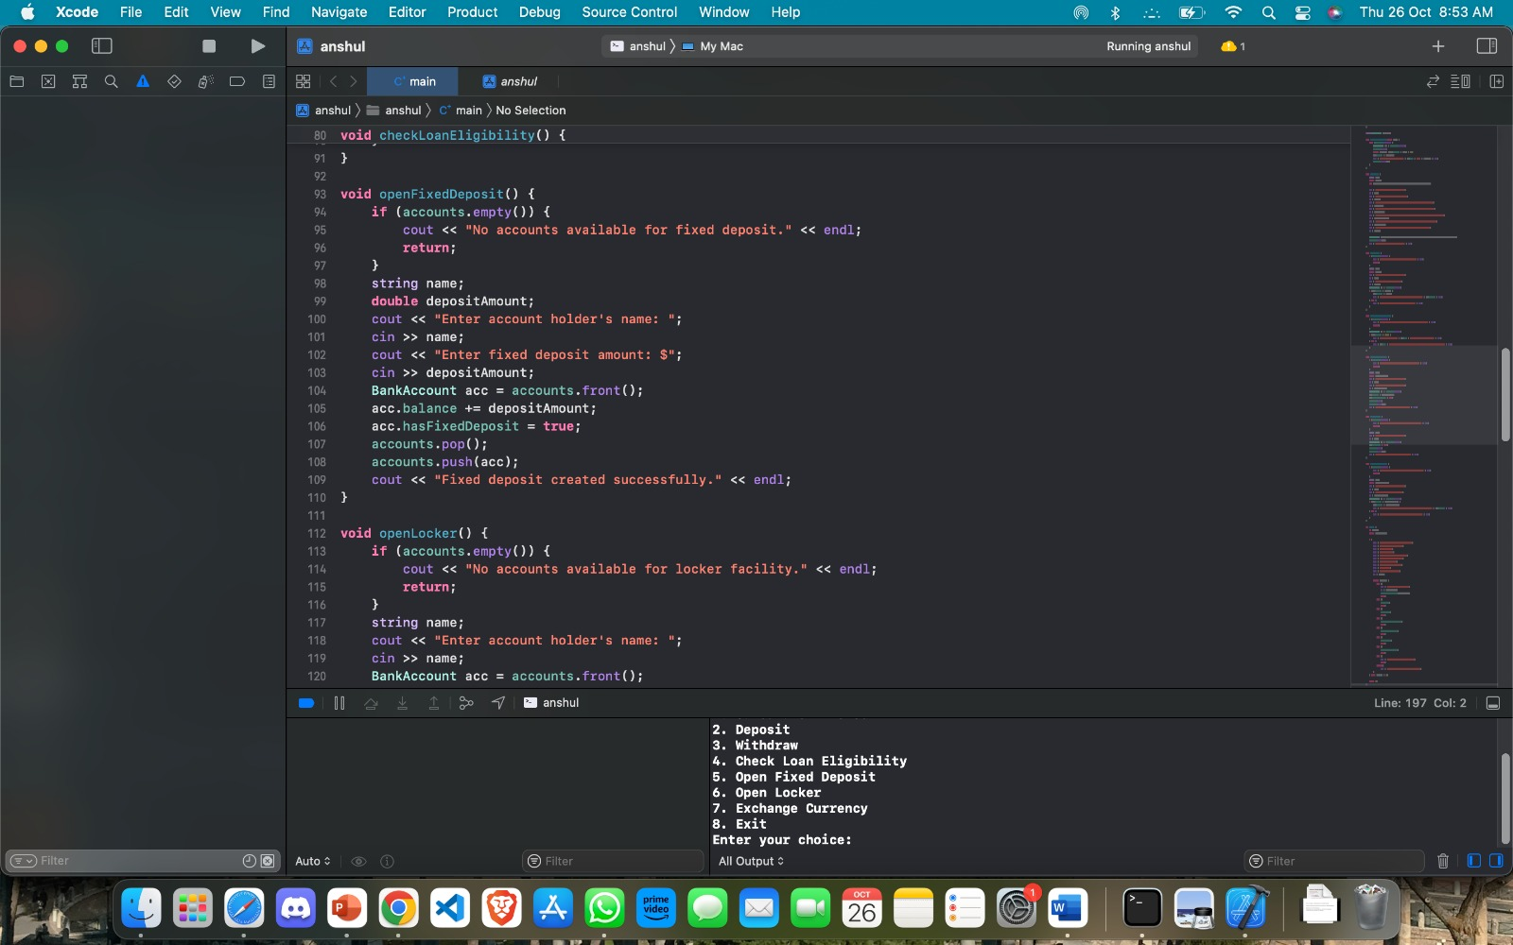

Slide 15
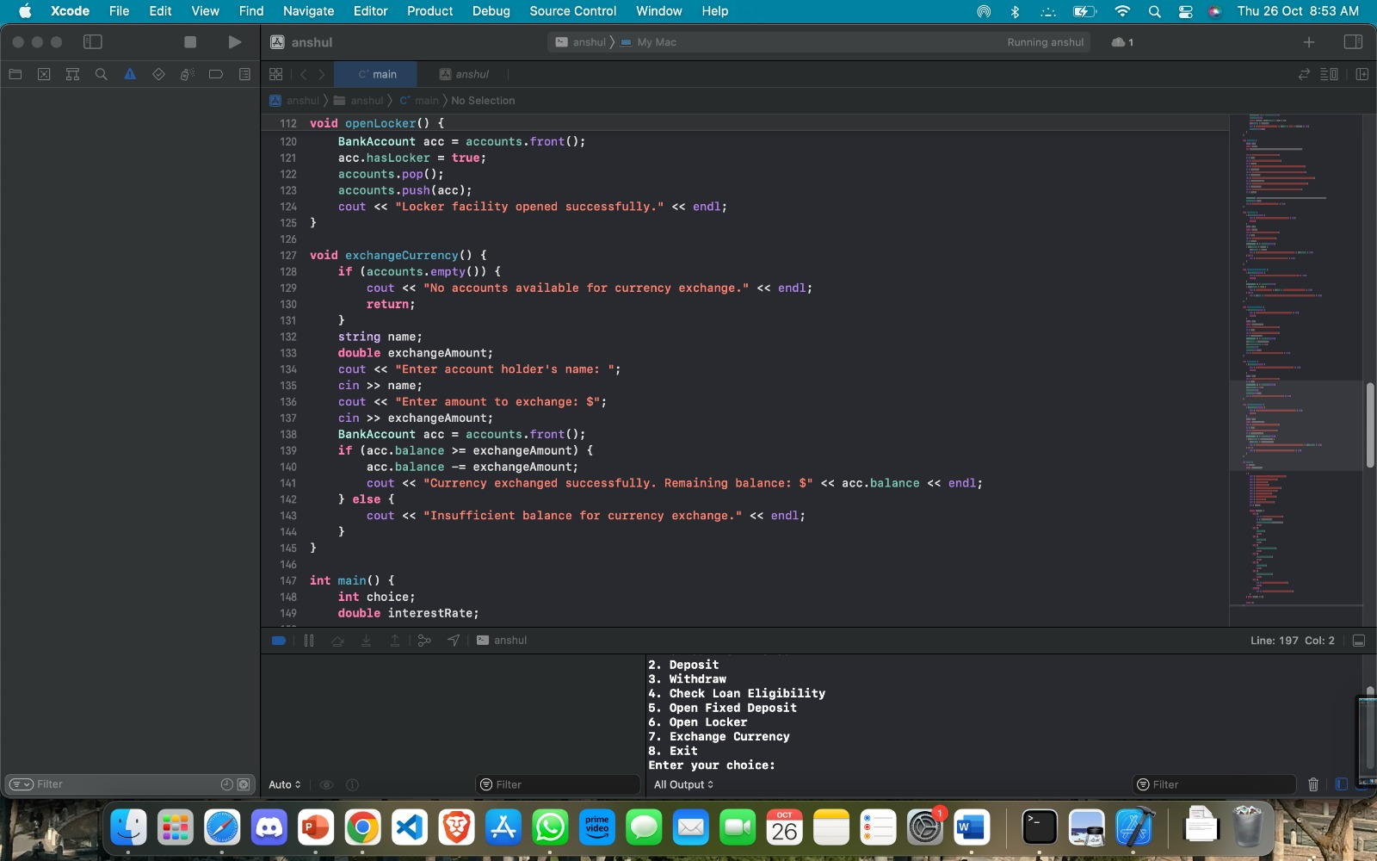

Slide 16
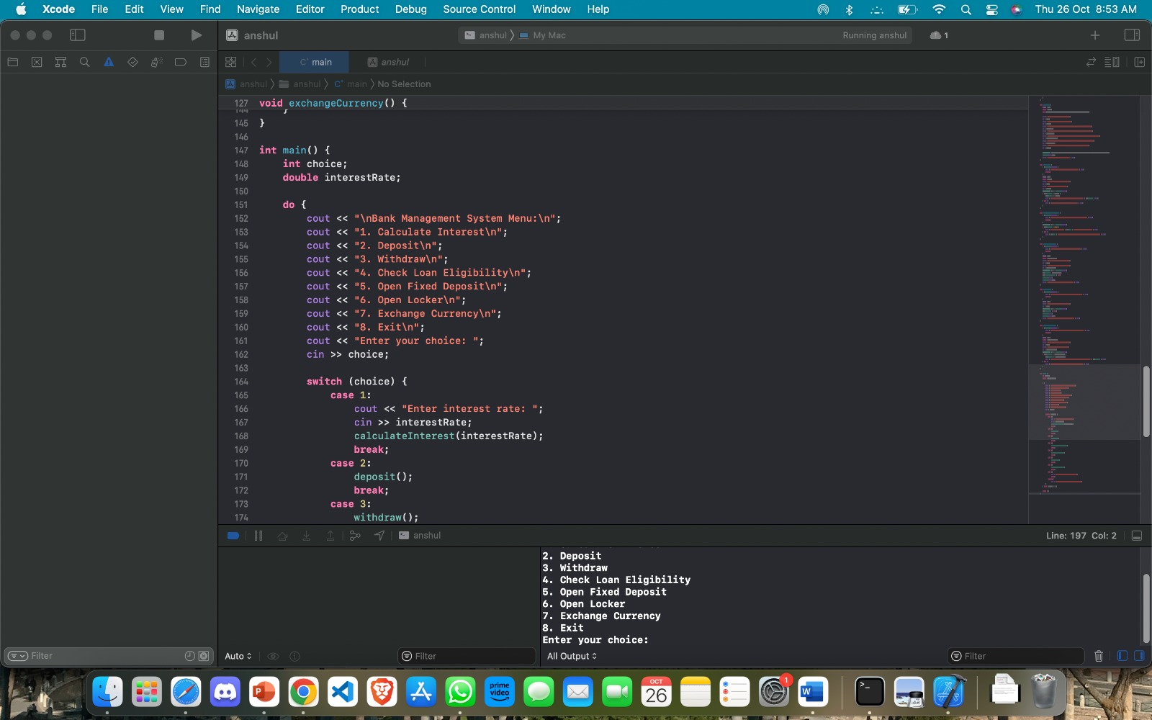

Slide 17
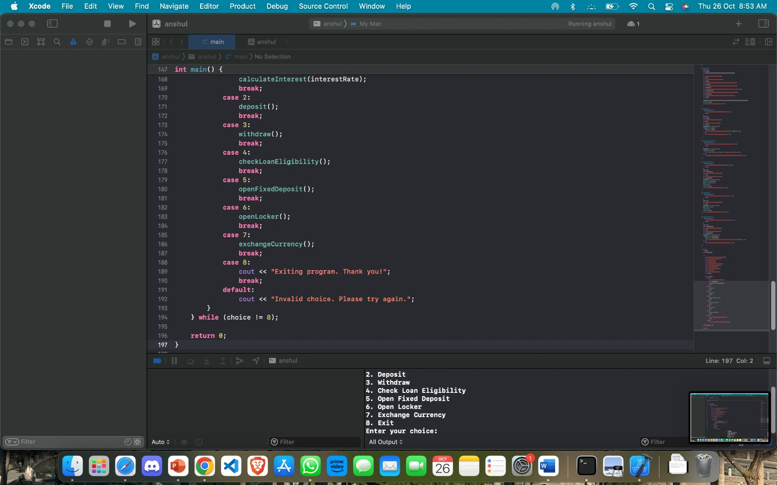

Slide 18
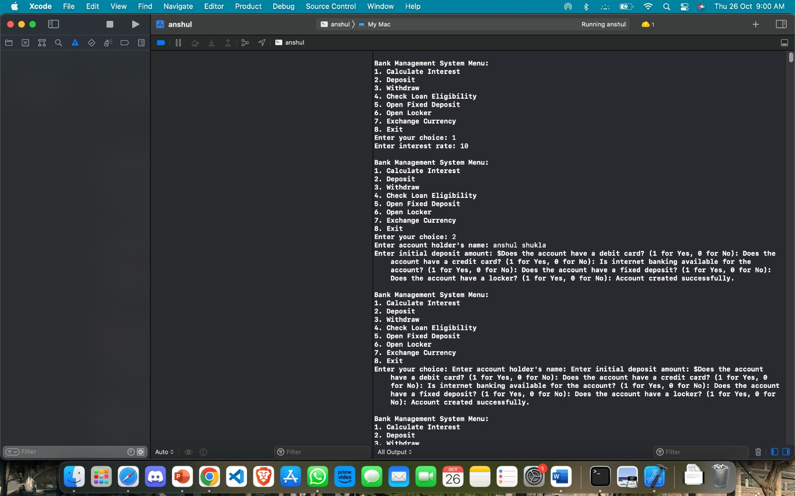
Output

Slide 19
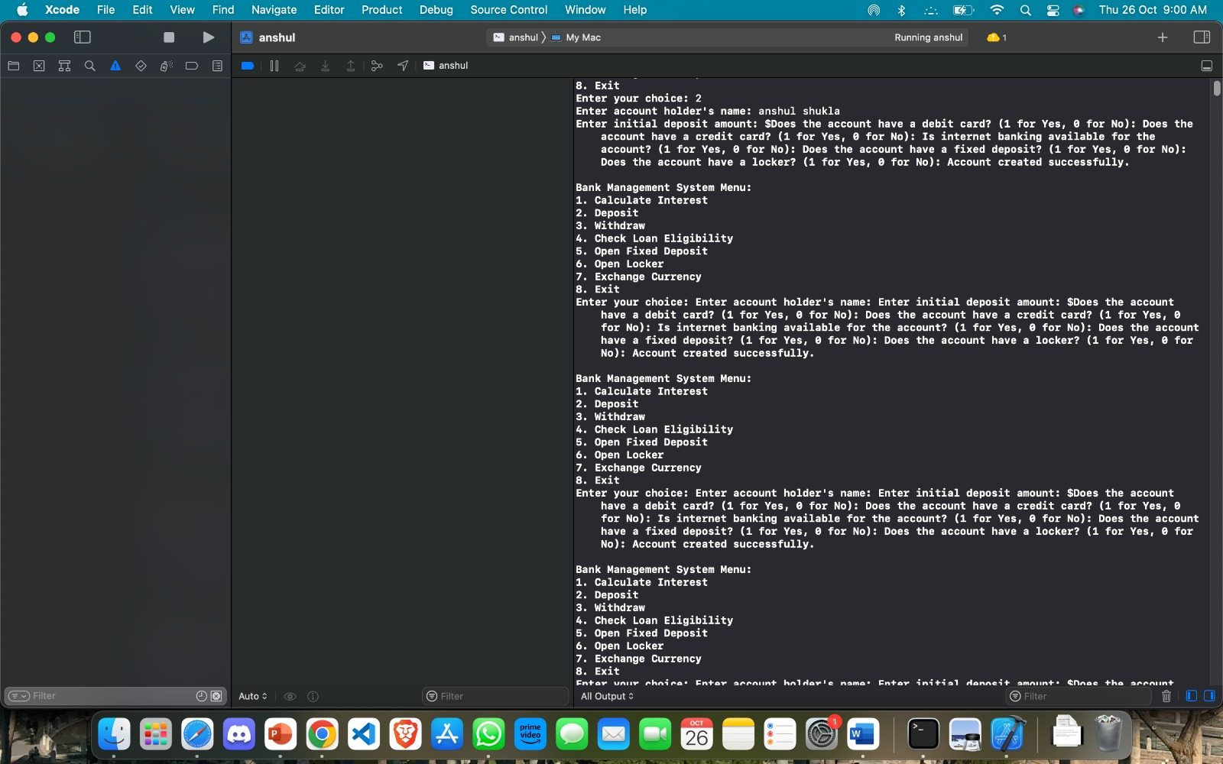

Slide 20
Time Complexity Discussion
The time complexity of the given code can be analyzed based on the operations performed in various functions and loops. Let's break it down:
The main function is a menu-driven program where the user selects various options. The time complexity for the menu-driven loop can be considered as O(1) since the number of options (menu items) is constant and does not depend on the input size.
Within the menu-driven loop, there are function calls for various operations like calculateInterest, deposit, withdraw, checkLoanEligibility, openFixedDeposit, openLocker, and exchangeCurrency. The time complexity of each of these functions depends on the operations they perform:
calculateInterest operates on a queue of accounts, and it processes each account once. The loop runs until the queue is empty. The time complexity of this function is O(N), where N is the number of accounts in the queue at any given time.

Slide 21
Time Complexity Discussion(contd.)
deposit, withdraw, checkLoanEligibility, openFixedDeposit, openLocker, and exchangeCurrency perform operations on the front of the accounts queue. In the worst case, these functions have a time complexity of O(1) because they operate on the front element of the queue, and the size of the queue does not affect the time complexity significantly. However, the complexity of these functions may be influenced by the input validation and user interactions within the functions.
The user inputs and menu interactions within each function generally have a time complexity of O(1) since they involve a fixed number of input operations and comparisons.

Slide 22
Summary
In summary, the overall time complexity of the main program is influenced by the operations within the calculateInterest function, which has a time complexity of O(N) in the worst case. The other functions and user interactions within the program have time complexities that are generally considered O(1) because they don't depend on the size of the input or the number of accounts in the queue.

Slide 23
Team Members
Rudrajit Dutta
Srijit Kundu
Diptayan Jash
RA2211003010913
RA2211003010881
RA2211003010890

Slide 24
Thank You

